Slide 1
MBD-Chip

Slide 2
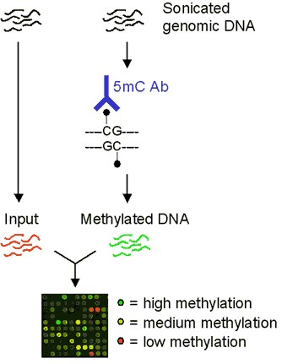
Workflow: Identify methylated regions

Slide 3
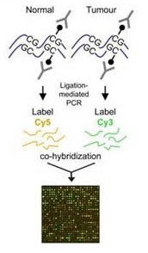
Workflow: differential methylation

Slide 4
Oyster DNA Tiling Array
3 x 720k design
Each feature ~100bp x 720k feature =72Mb for the microarray
720k
720k
720k
Notes:
Genome is about 600Mb so needed to reduce it..

Slide 5
Oyster DNA Tiling Array
Reducing the genome to most ‘informative’ parts (100Mb)
28k oyster genes (227Mb)
13k with evalue <1e-20 (total: 138Mb)
12k on scaffolds that cover 90% of genome (132kb)
Generate intervals that include the gene and 2kb upstream (promoter)
Randomly select 6500 (of the ~12k) intervals =100Mb
Notes:
Genome is about 600Mb so needed to reduce it..

Slide 6
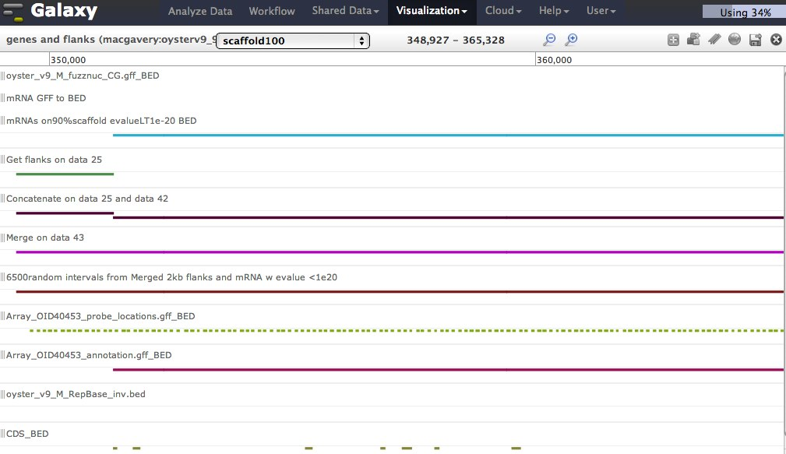

Slide 7
QC:
Dye swap
Input v. Input (CNV)
Validation
MBD-PCR
pyrosequencing
Example..

Slide 8
Guerrero-Bosagna et al 2010 (vinclozolin treated sperm F3 gen)
Experiment 1
Pooled DNA treatment*
Pooled DNA control*
Treated v Control rep1
R:G
G:R
Treated v Control rep2
R:G
G:R
Notes:
*after pooled did IP, several IPs (8)
Experiments 1 each pool was tested 4 times, twice w/ same dye, twice on same chip
Then experimet was replicated so treatment and conrol tested on 8 arrays

Slide 9
Guerrero-Bosagna et al 2010 (vinclozolin treated sperm F3 gen)
Experiment 1
Experiment 2
Pooled DNA treatment*
Pooled DNA control*
Treated v Control rep1
Treated v Control rep1
R:G
G:R
R:G
G:R
Treated v Control rep2
Treated v Control rep2
R:G
G:R
R:G
G:R
Notes:
*after pooled did IP, several IPs (8)
Experiments 1 each pool was tested 4 times, twice w/ same dye, twice on same chip
Then experimet was replicated so treatment and conrol tested on 8 arrays

Slide 10
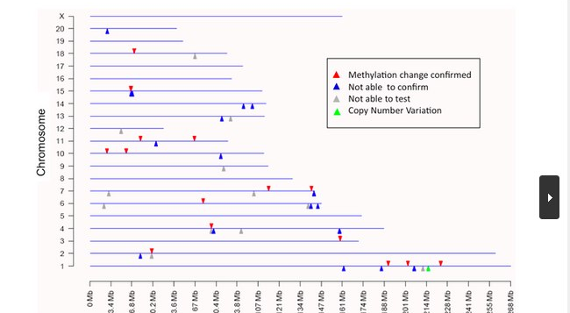
Skinner paper
Notes:
Validation
-mass spec thing
-pyrosequencing
-tried to validate all 52 regions, some could not be validated

Slide 11
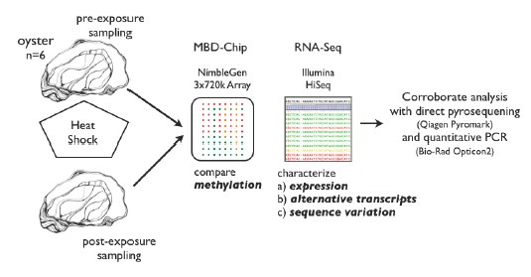
Chip #1: methylation changes after heat shock

Slide 12
Chip #1: methylation changes after heat shock
Animal A (MBD)
Pre: red
Post: green
Animal B
(MBD)
Pre: green
Post: red
Animal B
(input)
Pre: green
Post: red

Slide 13
Chip #2: methylation changes in response to EE2
Day 7
Control Pool: 4 females (across 3 tanks)
EE2 Pool: 8 females (select 4 across 3 tanks)
Pooled MBD (n=4)
Input
EE2: red
cntrl: green
EE2: green
cntrl: red
EE2: green
cntrl: red

